Slide 1
Introduction to Pandas
Learning Objectives
Create, manipulate, and alter Series and DataFrames with Pandas
Define and change the indices of Series & Dataframes
Use Pandas' functions and methods to change column types, compute summary statistics and aggregate data
Read, manipulate, and write data from csv, xlsx, json and other structured file formats
Expected Prior Knowledge
Experience of working with data using Data Analysis tools such as Excel.

Slide 2
Why Pandas?

Slide 3

Pandas is Python’s ETL package for structured data
Built on top of NumPy, designed to mimic the functionality of R data frames
Provides a convenient way to handle tabular data
Can perform all SQL functionalities, including group-by and join
Compatible with many other Data Science packages, including visualisation packages such as Matplotlib and Seaborn
Defines two main data types:
→ pandas.Series
→ pandas.DataFrame
What is pandas

Slide 4
Series

Slide 5
A series is a one-dimensional, single type array
Represents a column in a table.
It consists of two NumPy arrays:
→ Index array
→ Values array
Each element has a unique index (ID)
Indices do not have to be sequential
Like primary keys
series
Notes:
A series is a one-dimensional array that holding data of any type. It can be viewed as a column in a table.
It consists of two NumPy arrays:
→ Index array: stores the indices of the elements
→ Values array: stores the values of the elements
Each array element has a unique index (ID), contained in a separate index array.
If we reorder the series, the index moves with the element, so an index will always identify with the same element in the series.
Indices do not have to be sequential; they do not even have to be numbers.
Think of indices as being the primary keys for each row in a single column table.

Slide 6
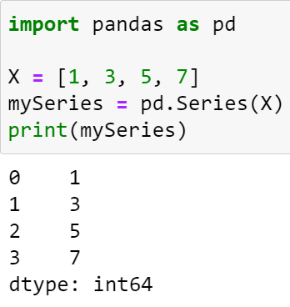
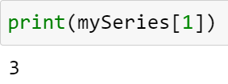
A Pandas series can be created from a Python list or a NumPy array:
The index starts from 0, and increments by 1 for each subsequent element in the series.
The index is used to access the corresponding value.
Creating series
Index array
values array

Slide 7
Series can be used like an array, except the indices must correspond to the elements in the index array
series.index returns the index array
series.values returns the values array
series[ind] is equivalent to series.loc[ind], returns the element in the series with ID equal to ind
series.iloc[i] returns the i-th element in the series
Querying series

Slide 8
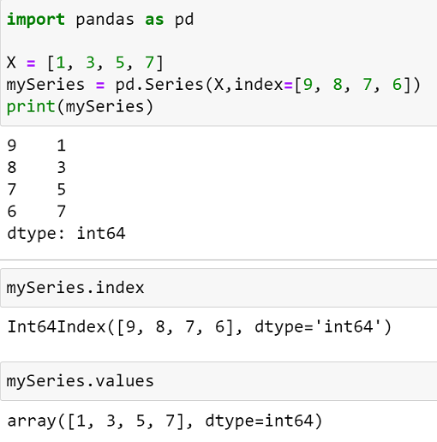
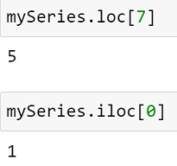
Querying series
Index 7
Position 0

Slide 9
DataFrames

Slide 10
A Pandas Data Frame represents a table, and it contains:
→ Data in form of rows and columns
→ Row IDs (the index array, i.e., primary key)
→ Column names (ID of the columns)
Equivalent to collection of Series
The row indices by default start from 0 and increase by one for each subsequent row.
Data frames are the data structures most suitable for analytics – rows representing observations and columns representing attributes of different data types.
Data frame
Notes:
A Pandas Data Frame represents a table, and it contains:
→ Data in form of rows and columns
→ Row IDs (the index array, i.e., primary key)
→ Column names (ID of the columns)
A Data Frame is equivalent to collection of Series with each Series representing a column
The row indices by default start from 0 and increase by one for each subsequent row, but just like Series they can be changed to any collection of objects.
Each row index uniquely identifies a particular row. If we reorder the rows, their indices go with them.
Data frames are the data structures most suitable for analytics – rows representing observations and columns representing attributes of different data types.

Slide 11
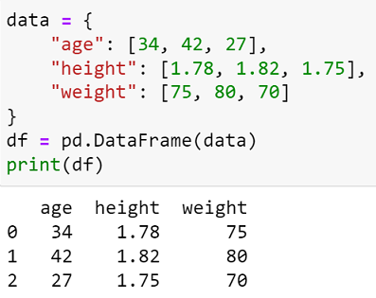
Creating from Python lists, or NumPy arrays:
Use a dictionary with column names as keys and a list of the row values
Creating from CSV files:
pandas.read_csv(csv_file_name)
The first row is used for column names
creating data frames

Slide 12
Reading In Data

Slide 13
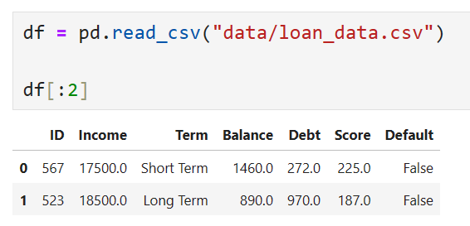
read_csv reads a comma delimited file into a DataFrame
Can pass a path or url to be read from
Parameters control how to read
E.g. whether to parse dates or not
Reading csv files
Notes:
Pandas makes parsing csv files much easier that using python alone. The read_csv function takes a filepath or url as its main parameter and loads the csv file in the destination into a Dataframe.
Default behaviour is that column headings are inferred, dates aren’t to be converted into specific Python types, and the DataFrame index is generated on load, but all of that can be changed (and more!) by passing parameters.

Slide 14
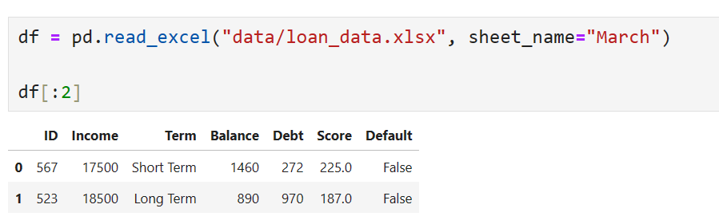
read_excel reads an excel file into a DataFrame
Pass a path to be read from, as well as the sheet
Parameters control how to read
E.g. whether to parse dates or not
Reading Excel files
Notes:
Similar to reading csv files, Pandas can use read_excel to load data in an excel spreadsheet into a DataFrame from a path. It helps to pass the sheet name, and you can specify the location in the sheet to read from.
A module called OpenPyXl is used to actually read data from the sheet. It actually reads the raw xlsx file.
A quirk to be aware of is that if a formula has been written to the file using the same module, when read it will still just be the formula, not the value it results in. Running the sheet in Excel itself is the only way to get the formula to evaluate.

Slide 15
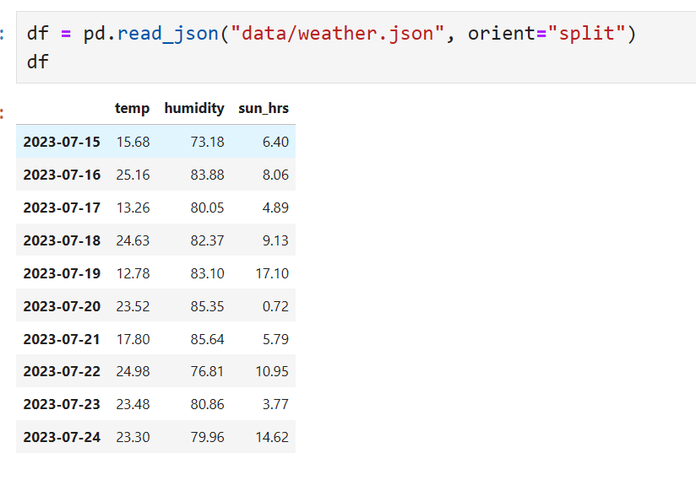
read_json reads a json file into a DataFrame
read_xml reads a json file into a DataFrame
Can pass a path or url to be read from
Parameters control how to read
Reading XML & JSON
Notes:
Pandas can parse XML and JSON files too, making the extraction of a Structured table from a semi-structured source much easier.

Slide 16
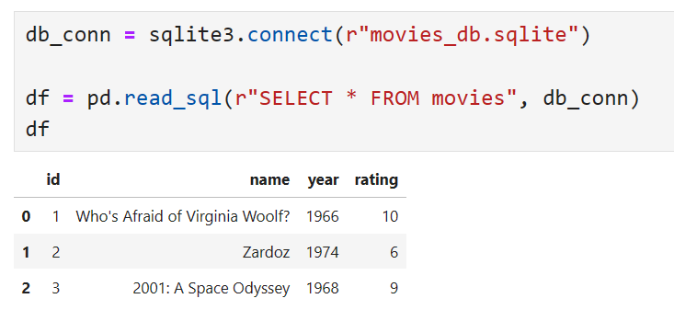
Querying SQL Tables
read_sql reads a the result of a SQL query into a DataFrame
Requires appropriate connection to be set up
Including correct credentials
Notes:
With a valid SQL database either installed or ODBC connection set up, Pandas can use the read_sql function to pass a String query to a database and the result will be read into a DataFrame.

Slide 17
Changing Types

Slide 18
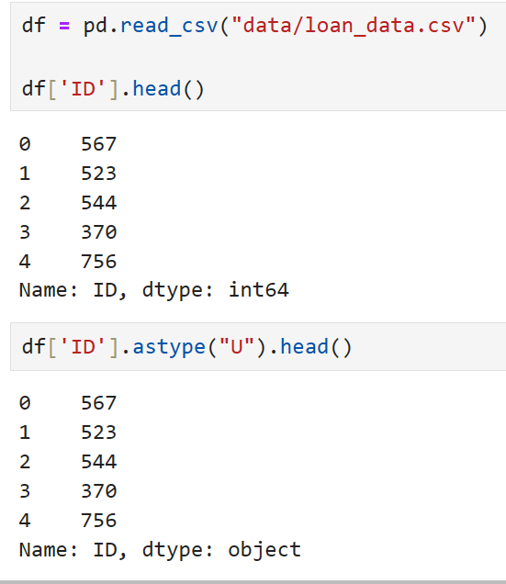
Ensuring data is of the correct type is important, both technically & statistically
The astype method can be used to do this to Series and DataFrames
Changing column types
Notes:
While Python itself isn’t a particularly type sensitive language, Pandas, using Numpy in it’s backend, is much more specific about types.
Furthermore, it is statistically relevant to ensure data are encoded as the appropriate type for correct processing to be possible.
Pandas extends the types available to Python in two main ways:
The introduction of Numpy precise types, which specify the generic type and the number of bits required to store them e.g. int32
The addition of extension types, which are either statistically or programmatically useful e.g. Category for Nominal/Ordinal variables
We can change types in two main ways also:
Series have the astype method, which will attempt to convert to the type given as a string parameter
Using the to_datetime function, which attempts to parse a string object as a datetime, demonstrated in the following slide

Slide 19
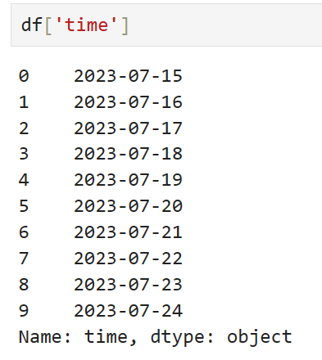
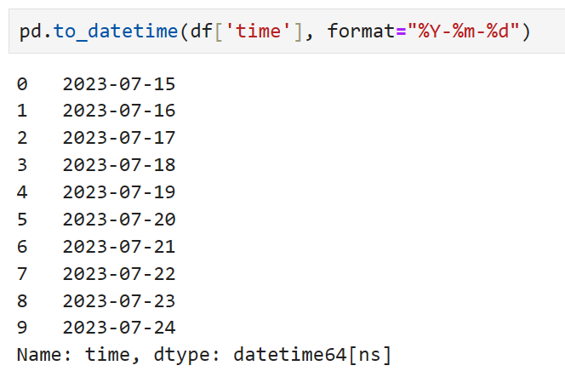
Parsing Dates & Times
Dates & times are often read in as objects by Pandas
Essentially strings
A specific function called to_datetime is used to parse these into datetime objects
Uses strftime
Can be done on file read, but discouraged
Notes:
Parsing dates and times in Pandas is based on the strftime function in Python. strftime is used to convert Python datetime objects to strings with a specific format using format codes. This can also be used in reverse. Pandas, when using to_datetime, will map a string object to a datetime object by matching the format string to the string object.
Some example format codes are listed below:
%d: Returns the day of the month, from 1 to 31
%m: Returns the month of the year, from 1 to 12.
%Y: Returns the year in four-digit format ( Year with century). like, 2021.
%y: Returns year in two-digit format ( year without century). like, 19, 20, 21
%A: Returns the full name of the weekday. Like, Monday, Tuesday

Slide 20
Indexing DataFrames

Slide 21
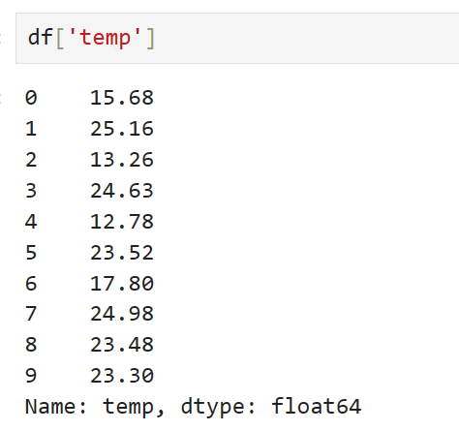
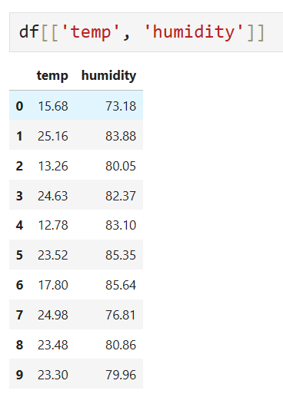
Getting entire columns:
my_dataframe[column_name]
Column Retrieval
Column with name X
Columns with names XX
Notes:
The primary index of a DataFrame is the columns it contains, and so Python style indexing can be used to retrieve single, selected, or slices of columns. Single columns are returned as series, while selections & slices are returned as DataFrames. Operations and functions applied to selected columns will only affect the underlying DataFrame if explicitly assigned.

Slide 22
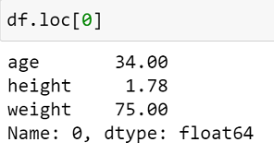
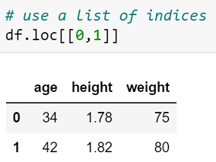
Getting entire rows:
my_dataframe.loc[row_id]
Row retrieval
Row with index 0
Rows with indices 0 and 1
Notes:
The main syntax for DataFrame row retrieval is using the loc property, which returns an inclusive selection of rows and columns *by index*.

Slide 23
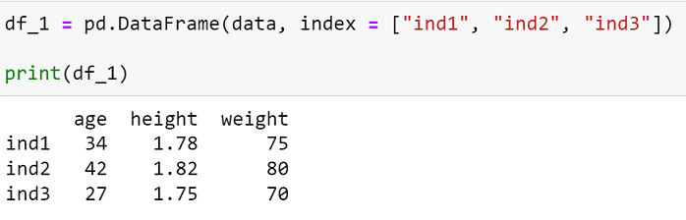
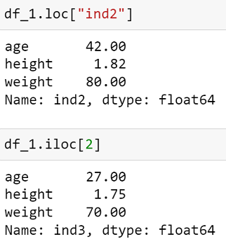
Indices can be named:
Named Row retrieval
Row with index “ind2”
Row with position 2

Slide 24
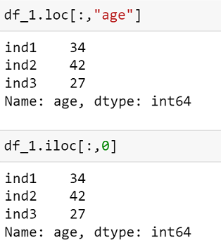
Getting entire columns:
my_dataframe.loc[:, col_name]
my_dataframe.iloc[y:,col_position]
Slicing DataFrames
Column “age”
Column with position 0
Notes:
We can use the iloc property to slice by integer position rather than by index. This is especially useful in conjunction with sorting.

Slide 25
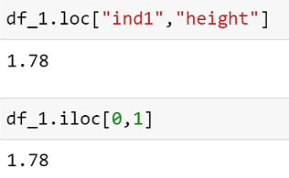
Getting individual elements from row and column IDs:
my_dataframe.loc[row_id, col_name]
my_dataframe.iloc[i, j]
Slicing DataFrames
Row index “ind1”
Column “height”
Row 0 Column 1

Slide 26
my_dataframe.loc[[id1, id2, id3], :]
returns rows id1, id2 and id3, all columns
my_dataframe.loc[:, [col1, col2, col3]]
returns columns col1, col2 and col3, all rows
my_dataframe.loc[[id1, id2, id3], [col1, col2, col3]] returns 3 by 3 table of rows id1, id2 and id3, columns col1, col2, and col3
Slicing Summary

Slide 27
Querying DataFrames

Slide 28
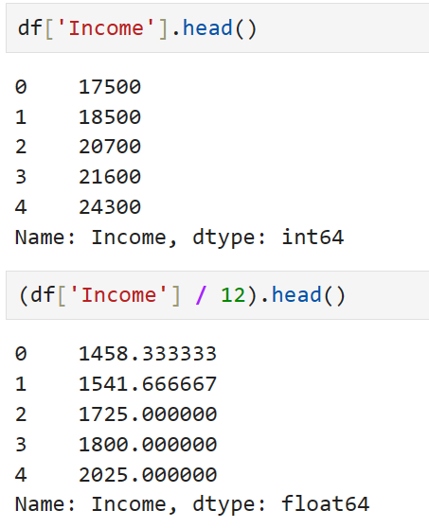
Like numpy, pandas broadcasts operations
i.e. we can perform calculations with columns like we do with single values
Broadcasting Operations
Notes:
Being built on numpy, pandas broadcasts operations row-wise, making computations with columns simple. The operators which can be used will depend on the column type, but generally speaking, all numeric & Boolean operators are valid for numeric types, and all Boolean operators for string types.
The results of Boolean operations can be combined, though pandas strays from pythons use of the and and or statements, favouring instead the operators & and |. Interestingly, ~ is the not operator.

Slide 29
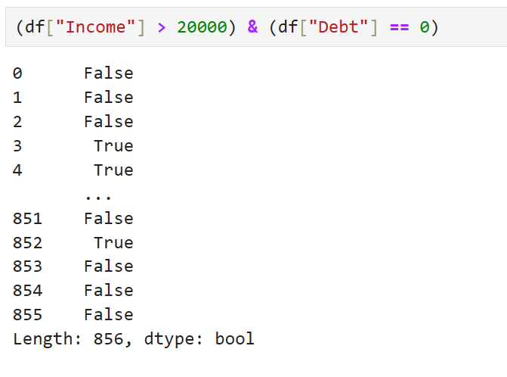
Symbolic Boolean operators can be used to combine conditions
Boolean Operators
Notes:
Some Boolean operators are detailed above

Slide 30
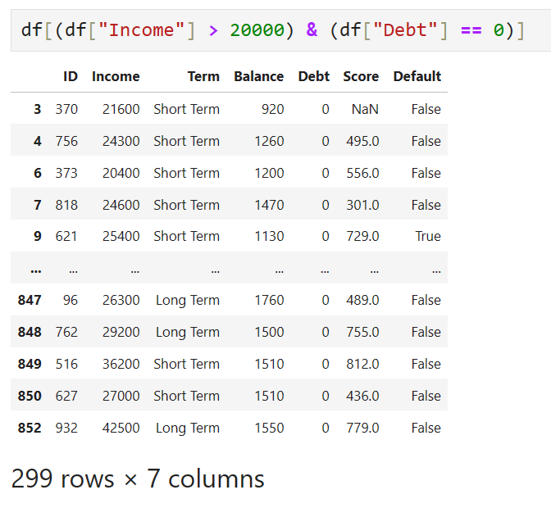
Dataframes can be filtered row-wise using a sequence of Trues & Falses
These can be generated by queries
Filtering
Notes:
As operations are applied row-wise, the result of Boolean operations (and Boolean returning functions) being applied to columns is a Series of Boolean values.
The Series of Boolean values can be used to filter the DataFrame, returning those rows for which the expression evaluated to true (i.e. for which the Series has a true value at that index).
This can be seen as equivalent to the SQL SELECT * FROM df WHERE cond;

Slide 31
Aggregation

Slide 32
Group By
Group table rows into sub-groups according to a specified criteria.
DataFrame
Series
Group | Name | Gender | Age
A | Alice | Female | 23
A | Charlie | Male | 25
Index | Name | Gender | Age
0 | Alice | Female | 23
1 | Bob | Male | 26
2 | Charlie | Male | 25
3 | Dave | Male | 24
Index | Group
0 | A
1 | B
2 | A
3 | B
Group | Name | Gender | Age
B | Bob | Male | 26
B | Dave | Male | 24
my_dataframe
criteria
my_dataframe.groupby(criteria)
Notes:
DataFrames can be grouped by column value, based on a condition, or by the application of a function. The groupby function is used to do this. It will group a DataFrame into sub-tables based on the condition, and an aggregate function or set of functions must be used to return a result table. Alternatively, sub-tables can be extracted by using get-group.
Transform can be used in a similar fashion to SQL window functions.

Slide 33
GROUP BY and:
Counting the number of rows in each group:
my_dataframe.groupby(criteria).size()
Sum of every numerical column in each group:
my_dataframe.groupby(criteria).sum()
Mean of every numerical column in each group:
my_dataframe.groupby(criteria).mean()
Group by
Notes:
Some example aggregate functions are detailed above.

Slide 34
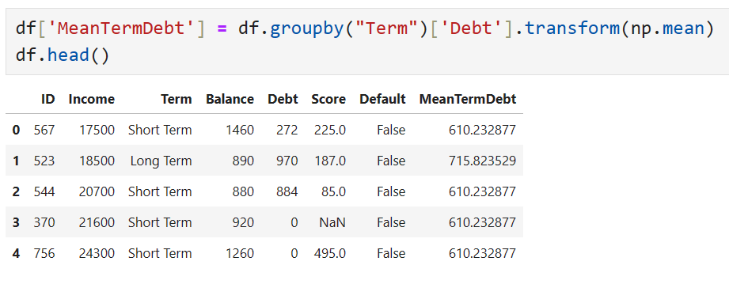
Transform is uses to calculate quantities over a group, but return as many rows as input
Can be used to add e.g. a grouped average column
Transform
Notes:
Transform can be used in a similar fashion to SQL window functions.

Slide 35
05_Introduction_to_Pandas_Exercise.docx
Exercise

Slide 36
Learning check
Think about your answers to these questions
What is the difference between Series & DataFrames?
Are DataFrame indices fixed?
Which functions can we use to change column types? What types does Pandas use? Do we use the same functions for time data?
Which types of file can Pandas read & write from?

Slide 37
How did you get on?
Learning Objectives
Create, manipulate, and alter Series and DataFrames with Pandas
Define and change the indices of Series & Dataframes
Use Pandas' functions and methods to change column types, compute summary statistics and aggregate data
Read, manipulate, and write data from csv, xlsx, json and other structured file formats

